Slide 2

What is Python?
Python is interpreter language Guido van Rossum, released in 1991.
Python is a programming language that lets you work more quickly and integrate your systems more effectively. (python.org)
Notes:
Python merupakan Bahasa pemograman tingkat tinggi yang dibuat oleh Guido van Rossum, dan released pada tahun 1991.
Python banyak digunakan untuk membuat berbagai macam program, seperti: program CLI, Program GUI (desktop), Aplikasi Mobile, Web, IoT, Game, Program Hacking, dsb.
Python dikenal dengan Bahasa pemograman yang mudah dipelajari, karena struktur sintaknya rapi dan mudah untuk dipahami

Slide 3
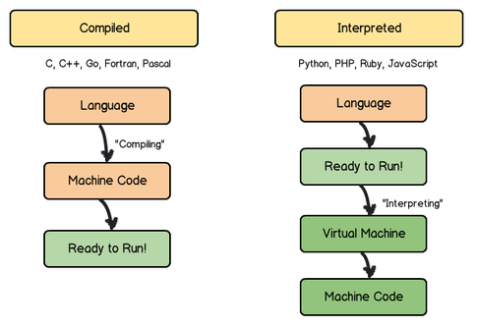
What is Python?
Python is interpreted language, what is interpreter language?
Notes:
In computer science, an interpreter is a computer program that directly executes instructions written in a programming or scripting language, without requiring them previously to have been compiled into a machine language program. An interpreter generally uses one of the following strategies for program execution:
Parse the source code and perform its behavior directly;
Translate source code into some efficient intermediate representation and immediately execute this;
Explicitly execute stored precompiled code^{[1]} made by a compiler which is part of the interpreter system.

Slide 4
Scripting vs Compiling Language
Applications of Scripting Languages :
To automate certain tasks in a program
Extracting information from a data set
Less code intensive as compared to traditional programming languages
Applications of Programming Languages :
They typically run inside a parent program like scripts
More compatible while integrating code with mathematical models
Languages like JAVA can be compiled and then used on any platform

Slide 5
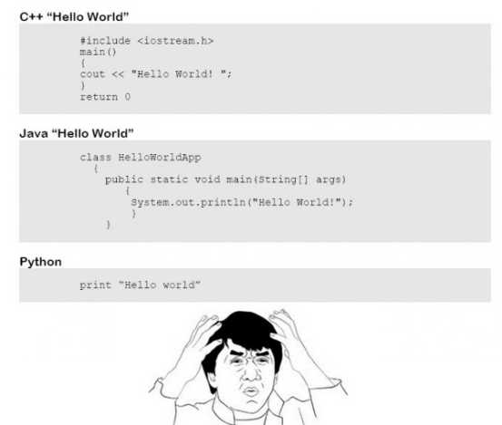
Why we learn to Python?
Easy to develop
Can create to develop many products (Website, Desktop, and Machine Learning Model)

Slide 6
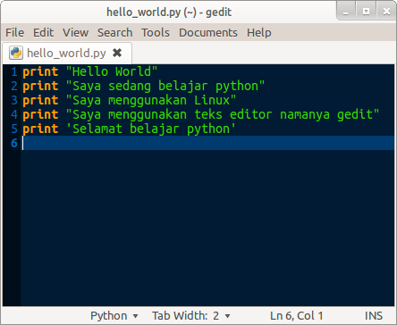
How to create Python Script
We can write in editor like notepad, and etc to save python script.
To create python script, you can save using notepad as script_name.py (all extensions) or run a command python script_name.py.

Slide 7
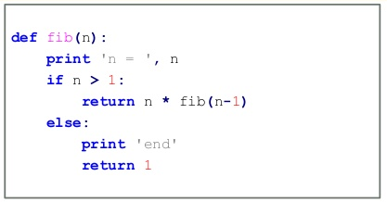
5 Rule to Write Python
How to Write Statement
String
Naming Convention
Programming Block of Statement
Comment

Slide 8


Write a statement
Statement is instruction or command that will be executed by computer.
Python use semicolon (;) to divide two statements in one line.

Slide 9


String
String is compound of character.
String is written by using double quote (“ ”) or single quote (‘ ’).
You can enter new line on string by using triple of double quote (“”” “””)

Slide 10

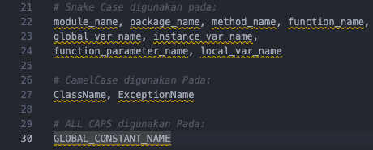
Naming Convention
Python is case sensitive means you need to comply on capital or lower case (e.g: judul, Judul)
If you defined a variable name as judul, and you call your variable as Judul, it will show up an error (variable is not found)
Python is using snake case to define variable means every words must split by underscore ( _ ) (e.g: angka_pertama, sisa_bagi)

Slide 11
Naming
Python use CamelCase to define class
To define constant variable (variable that will be used in one file) Python use ALL CAPS and snake_case combined (e.g: PI)

Slide 12
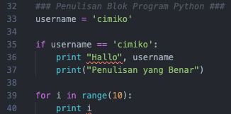

Block statement
Block is list of instructions that will be run in one place.
Block is written by using tab or four times of blank space (to make a different of code).

Slide 13
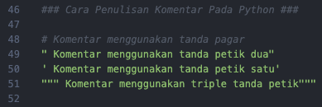
Comment
Comment is one or many lines that will be not execute to give any knowledge about what is python script file using for to another programmer.
Comment also can be used for skip any instructions in Python.
There are many ways to write a comment in python:
Use number sign/hash symbol (#).
Use triple of number sign/hash symbol (###).
Use double quote or single quote (“ “) atau (‘ ‘).
Use triple of double quote (“”” “””).

Slide 14
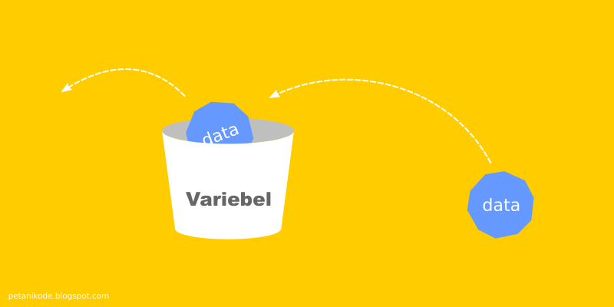
Variable and Data Type in Python
Variable is a place to store a data, meanwhile data type is content that we store.
Variable is mutable means its value can be changed.

Slide 15
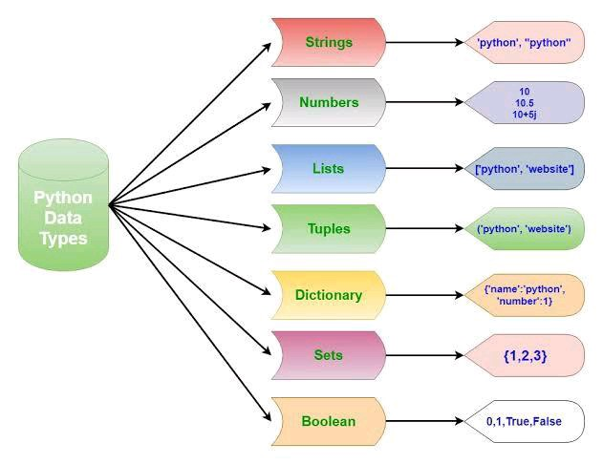
Data Type in Python

Slide 16
List
Lists are the most versatile of Python's compound data types. A list contains items separated by commas and enclosed within square brackets ([]).
To some extent, lists are similar to arrays in C. One difference between them is that all the items belonging to a list can be of different data type.
The values stored in a list can be accessed using the slice operator ( [ ] and [ : ] ) with indexes starting at 0 in the beginning of the list and working their way to end-1.
The plus ( + ) sign is the list concatenation operator, and the asterisk ( * ) is the repetition operator.

Slide 17
List
list = [ 'abcd', 786 , 2.23, 'john', 70.2 ]
tinylist = [123, 'john']
print list # Prints complete list
print list[0] # Prints first element of the list
print list[1:3] # Prints elements starting from 2nd till 3rd
print list[2:] # Prints elements starting from 3rd element
print tinylist * 2 # Prints list two times
print list + tinylist # Prints concatenated lists
Output:
['abcd', 786, 2.23, 'john', 70.2]
abcd
[786, 2.23]
[2.23, 'john', 70.2]
[123, 'john', 123, 'john']
['abcd', 786, 2.23, 'john', 70.2, 123, 'john']

Slide 18
Tuple
A tuple is another sequence data type that is similar to the list. A tuple consists of a number of values separated by commas. Unlike lists, however, tuples are enclosed within parentheses.
The main differences between lists and tuples are: Lists are enclosed in brackets ( [ ] ), and their elements and size can be changed, while tuples are enclosed in parentheses ( ( ) ) and cannot be updated. Tuples can be thought of as read-only lists.

Slide 19
Tuple
tuple = ( 'abcd', 786 , 2.23, 'john', 70.2 )
tinytuple = (123, 'john')
print tuple # Prints complete list
print tuple[0] # Prints first element of the list
print tuple[1:3] # Prints elements starting from 2nd till 3rd
print tuple[2:] # Prints elements starting from 3rd element
print tinytuple * 2 # Prints list two times
print tuple + tinytuple # Prints concatenated lists
OUTPUT:
('abcd', 786, 2.23, 'john', 70.2)
abcd
(786, 2.23)
(2.23, 'john', 70.2)
(123, 'john', 123, 'john')
('abcd', 786, 2.23, 'john', 70.2, 123, 'john')

Slide 20
Dictionary
Python 's dictionaries are hash table type. They work like associative arrays or hashes found in Perl and consist of key-value pairs.
Keys can be almost any Python type, but are usually numbers or strings. Values, on the other hand, can be any arbitrary Python object.
Dictionaries are enclosed by curly braces ( { } ) and values can be assigned and accessed using square braces ( [] ).

Slide 21
Dictionary
dict = {}
dict['one'] = "This is one"
dict[2] = "This is two“
tinydict = {'name': 'john','code':6734, 'dept': 'sales'}
print dict['one'] # Prints value for 'one' key
print dict[2] # Prints value for 2 key
print tinydict # Prints complete dictionary
print tinydict.keys() # Prints all the keys
print tinydict.values() # Prints all the values
OUTPUT:
This is one
This is two
{'dept': 'sales', 'code': 6734, 'name': 'john'}
['dept', 'code', 'name']
['sales', 6734, 'john']

Slide 22
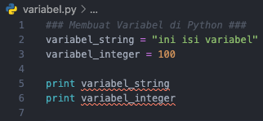
Define a variable
Variable can be defined with format (nama_variabel = <nilai>).
We can see what is inside its variable with using command print.

Slide 23
How to convert data type
Function | Description
int(x [,base]) | Converts x to an integer. base specifies the base if x is a string.
long(x [,base] ) | Converts x to a long integer. base specifies the base if x is a string.
float(x) | Converts x to a floating-point number.
complex(real [,imag]) | Creates a complex number.
str(x) | Converts object x to a string representation.
repr(x) | Converts object x to an expression string.
eval(str) | Evaluates a string and returns an object.
tuple(s) | Converts s to a tuple.
list(s) | Converts s to a list.
set(s) | Converts s to a set.
dict(d) | Creates a dictionary. d must be a sequence of (key,value) tuples.
frozenset(s) | Converts s to a frozen set.
chr(x) | Converts an integer to a character.
unichr(x) | Converts an integer to a Unicode character.
ord(x) | Converts a single character to its integer value.
hex(x) | Converts an integer to a hexadecimal string.
oct(x) | Converts an integer to an octal string.

Slide 24
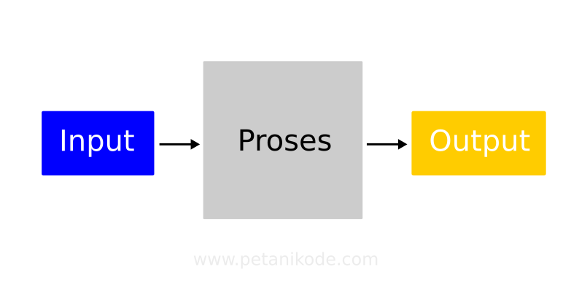
Input - Output
This is how we are processing tasks
Input is prerequisites of doing task
Process is how to do task
Output is result of task

Slide 25
Input – Output (Example)
Eating:
Input: Food
Process: Human Digestion System
Output: Energy

Slide 26
Input – Output (Example)
Calculator:
Input: Numbers
Process: Math Operations (Addition, Substraction, Multiply, Divison)
Output: Number

Slide 27
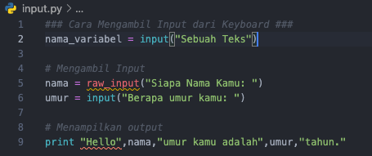
How to get input from keyboard
Python use input() and raw_input() to take inputs from keyboard.
Python3 not using raw_input() anymore meanwhile are input will be treated as string.
If we define variable to store input means its variable will store anything that we type on keyboard.

Slide 28

Output
To show teks in our console use print() command.
print() command must insert with string. To combine between string and variable, python must use (+).

Slide 29
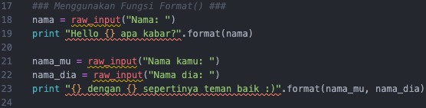
Use string format()
format() is use to concat between variable and text menggabungkan isi variabel dengan teks.
{} on sentence will be replaced by value of variable nama.

